Slide 1

DATA MINING AMES SALMONELLA TEST RESULTS FOR CARCINOGENICITY AND MUTAGENICITY
TEAM MEMBERS:-
Sucharu Gupta;
Nagadhatri Chennavajula;
Andrew Wong;
Sprush Ujjwal

Slide 2
DATA SET DETAILS
GENETOX_Bacterial mutagenicity_NTP data is in chemical-in- rows format, comma-separated values.
GENETOX_Bacterial mutagenicity_NTP.txt is 640.9MB.
final_project_data folder in Project directory has 3 files:
● GENETOX_Bacterial mutagenicity_NTP.txt
● gene.train.csv (training data, 1.5MB)
● Gene.valid.csv (validation data, 354 KB)
● Test.data.csv (test data, 459 KB)

Slide 3
Goals and Requirements
Primary:
1. Provide a table to user to see from the test data if there are chemicals with matching inputs.
2. Users can check on the blog, toxicity of the chemical based on the given inputs.
3. Output should be mutagen or non-mutagen

Slide 4
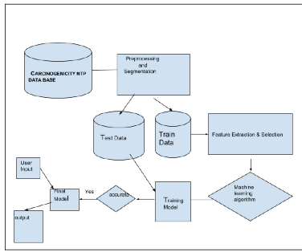
Architecture Diagram

Slide 5
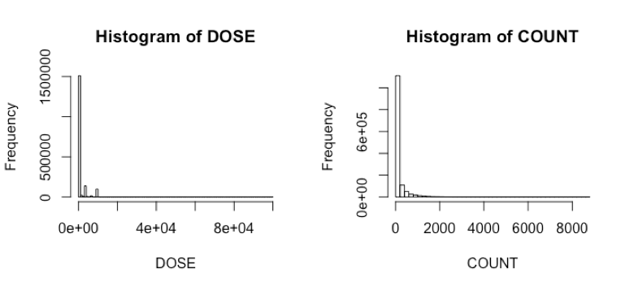
Data Patterns

Slide 6
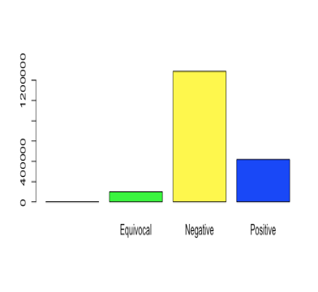
STUDY CONCLUSION PLOT

